Slide 1




MEET AND GREET!
Welcome to DUCS , Juniors
MCA, MSc | 2023-2025
Dept. of Computer Science, University of Delhi

Slide 2
INTRODUCTION
Aao jane tum hame aur hum tumhe😊
2023 Orientation Session | DUCS | Dept. of Computer Science, University of Delhi

Slide 3
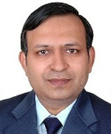
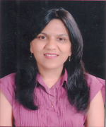
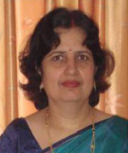
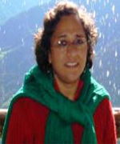
FACULTY
Dr. Naveen Kumar Professor Head of the Department & Dean of the Faculty | Dr. Neelima Gupta Professor
Dr. Punam Bedi Senior Professor | Dr. Vasudha Bhatnagar Professor
2023 Orientation Session | DUCS | Dept. of Computer Science, University of Delhi

Slide 4
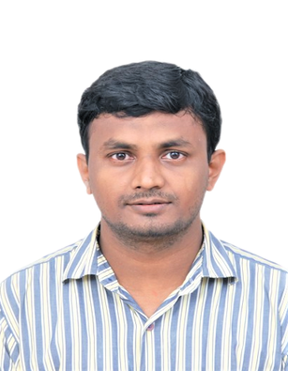
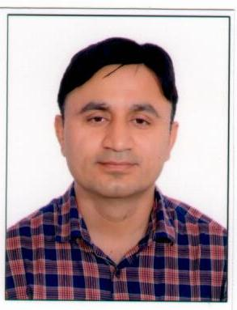
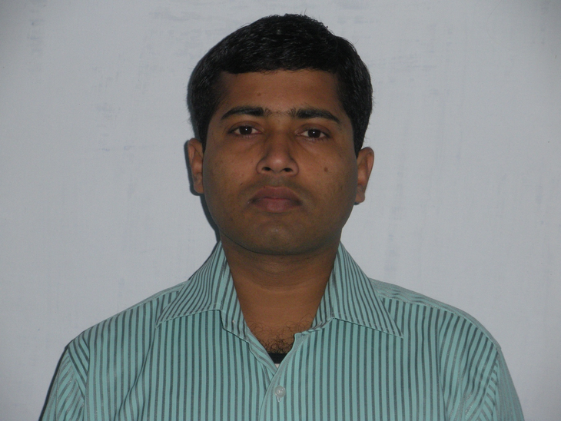
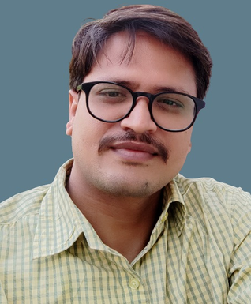
FACULTY
Dr. Dilip Senapati Associate Professor | Dr. Om Pal Associate Professor
Dr. Mantosh Biswas Associate Professor | Dr. Vikas Kumar Assistant Professor
2023 Orientation Session | DUCS | Dept. of Computer Science, University of Delhi

Slide 5
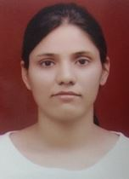
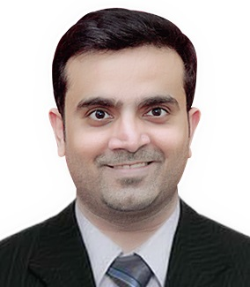
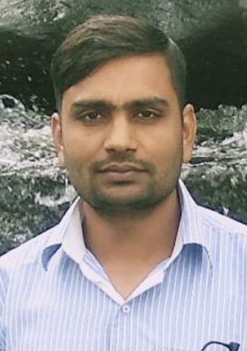
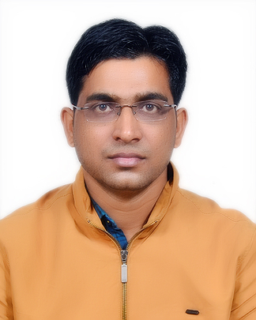
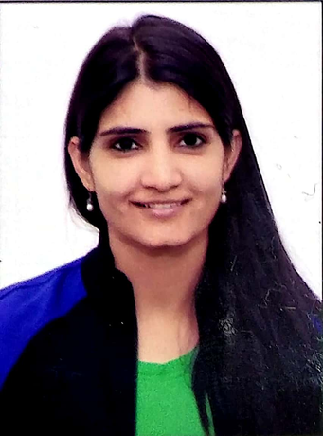
FACULTY
Dr. Bharti Assistant Professor | Dr. Ankit Rajpal Assistant Professor
Dr. Kuldeep Singh Assistant Professor | Dr. Yogendra Meena Assistant Professor
Dr. Reena Kasana Assistant Professor
2023 Orientation Session | DUCS | Dept. of Computer Science, University of Delhi

Slide 6
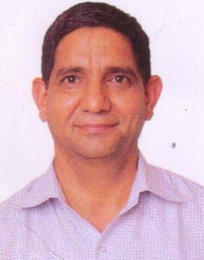
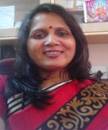
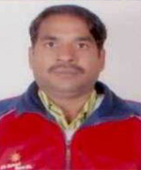
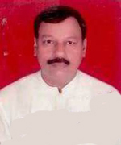
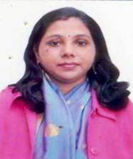
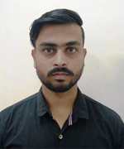
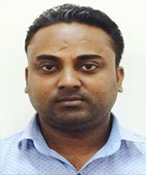
ADMINISTRATIVE STAFF
TECHNICAL STAFF
Mauji Ram Senior Assistant | Devki Rawat Technical Assistant
Rajbir Giri Office Attendant | Anand Singh Laboratory Assistant
Himani Saini Junior Assistant cum Typist | Nishant Baniwal Laboratory Attendant
Balkishan Office Attendant (on Contract)
Shashi Patwal Junior Assistant cum Typist
2023 Orientation Session | DUCS | Dept. of Computer Science, University of Delhi

Slide 7
DUCS PANEL
Aditya Shiromani - PRESIDENT(MCA)
Sajal Maheshwari - VICE PRESIDENT(MSc)
Vaishnavi - General Secretary(MSc)
Hardik Chawda- Treasurer (MCA)
Priya Gaur -JOINT SECRETARY(MCA)
2023 Orientation Session | DUCS | Dept. of Computer Science, University of Delhi
Notes:
Workshops
Social Activities
Sankalan
National Events
Expert Talks

Slide 8
EVENTS
Tech Fest- Sankalan
Srijan Magazine
Diwali Night
Societies - Ex: Designing, Marketing.
Interactive sessions with the Alumni and conduct of seminars.
Sports Day
2023 Orientation Session | DUCS | Dept. of Computer Science, University of Delhi
Notes:
Workshops
Social Activities
Sankalan
National Events
Expert Talks

Slide 9

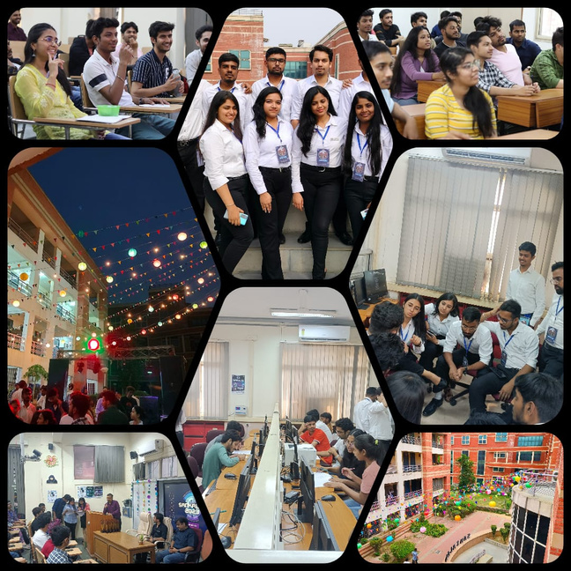
EVENTS
SANKALAN : Annual Tech Fest
This is the annual tech fest of DUCS which has been our pride for more than a decade now. Since its inception in 2005, it has been a part & parcel of lives at DUCS. Both Intra and Inter Sankalan includes loads of tech , non-tech and fun events.
2023 Orientation Session | DUCS | Dept. of Computer Science, University of Delhi

Slide 10
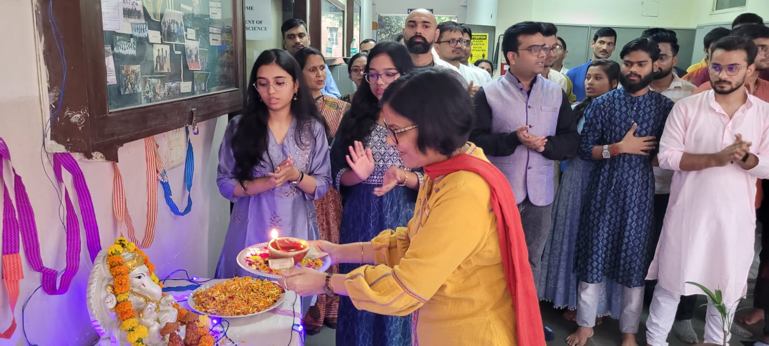
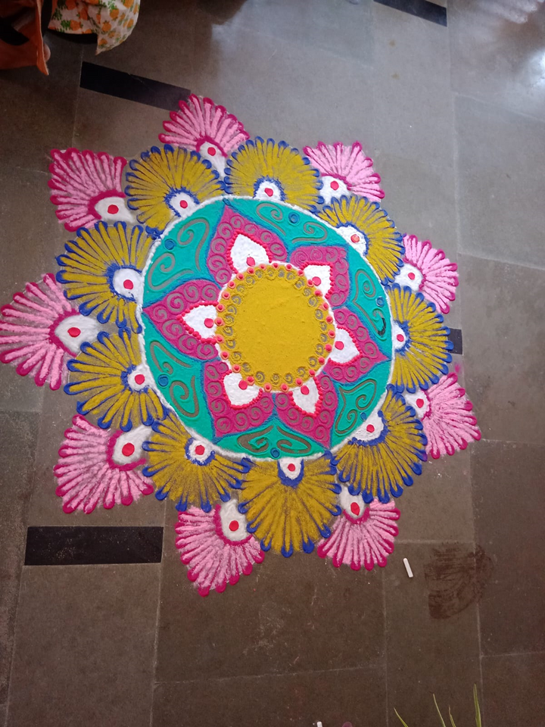
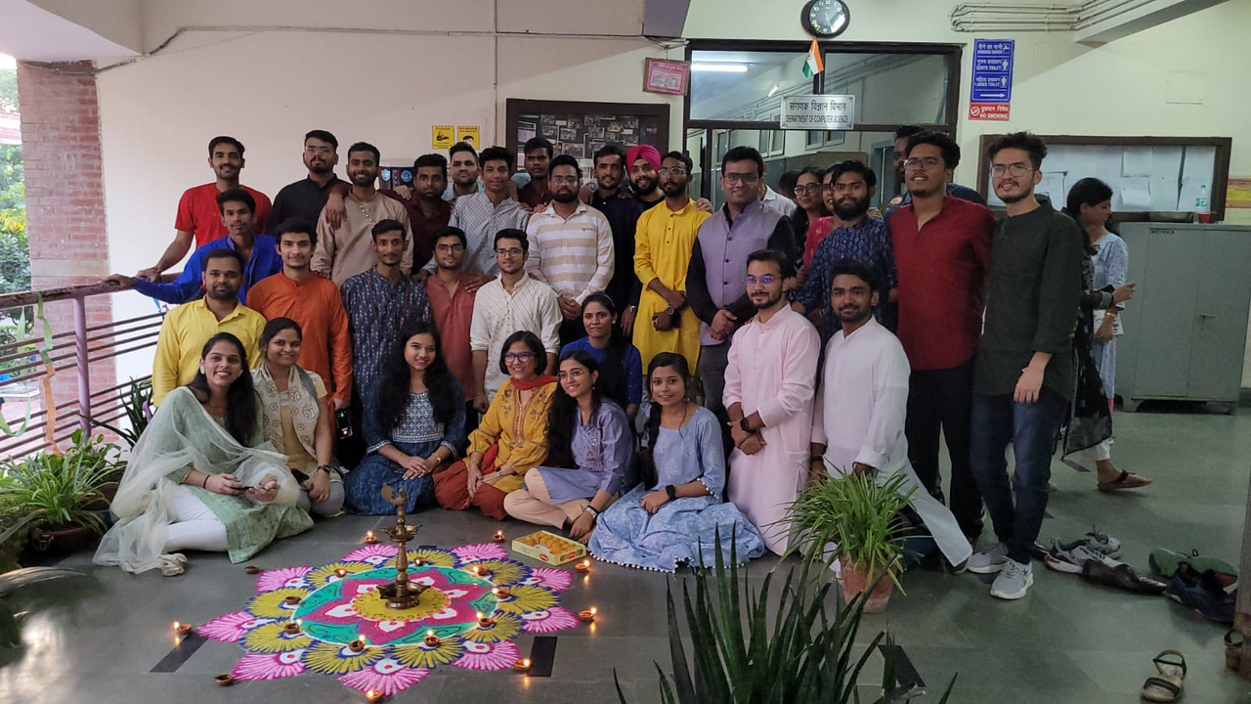
EVENTS
DIWALI CELEBRATION
Our department celebrates the festival every year in the true sense by spreading joy and light up the world.
2023 Orientation Session | DUCS | Dept. of Computer Science, University of Delhi

Slide 11
FAAYDE (BENEFITS)
-> Scholarship
-> Labs & Library (CSL)
-> Laptop (for EWS students)
-> health card
-> DU Hostel
-> University Students Perks
2023 Orientation Session | DUCS | Dept. of Computer Science, University of Delhi

Slide 12
SCHOLARSHIP
National Scholarship Portal.
FSS.
ICCR (Foreign students)
2023 Orientation Session | DUCS | Dept. of Computer Science, University of Delhi

Slide 13
HOSTEL
BOYS
PG Men’s Hostel
Gwyer Hall
DS Kothari Hostel
Mansarovar Hostel
GIRLS. (Reg already opened)
University Hostel for Women
Meghdoot Hostel
Rajiv Gandhi Hostel Complex for Girls
2023 Orientation Session | DUCS | Dept. of Computer Science, University of Delhi

Slide 14
HOSTEL ENROLL. PROCESS
Collect offline form from the hostel only.
Fill and get it signed by the HOD.
Attach your self-attested doc(10/12/UG/RANK CARD/CATEGORY if applicable/ ADDRESS PROOF).
2 local guardian who should have address of Delhi.
Fitness Certificate from WUS health care.
2023 Orientation Session | DUCS | Dept. of Computer Science, University of Delhi

Slide 15
LIBRARY
Collect the library registration card from CSL.
Fill the form and get attested from the office.
Then, submit it into library.
2023 Orientation Session | DUCS | Dept. of Computer Science, University of Delhi

Slide 16
HEALTH CARD
WUS near Patel Chest.
Facilities:(Monthly subscription)
Consultation free.
Medication and diagnosis free.
2023 Orientation Session | DUCS | Dept. of Computer Science, University of Delhi

Slide 17
FREE STUFF
using DU official mail-id
Microsoft Office 365(Online and mobile app).
GitHUB student developer pack.
Free credits on AZURE.
FILMORA & Pixlr.
Libre Office.
Flipkart plus membership (upload student id).
DISCOUNTS (you have to apply for verification)
UNiDAYS 10% discount on apple products with free accessories.
15-20% discount on other brand products.
2023 Orientation Session | DUCS | Dept. of Computer Science, University of Delhi

Slide 18

OUR COMMUNITY
https://discord.gg/f48FBSdS
2023 Orientation Session | DUCS | Dept. of Computer Science, University of Delhi

Slide 19
OLD VS NEW COURSE
2023 Orientation Session | DUCS | Dept. of Computer Science, University of Delhi

Slide 20

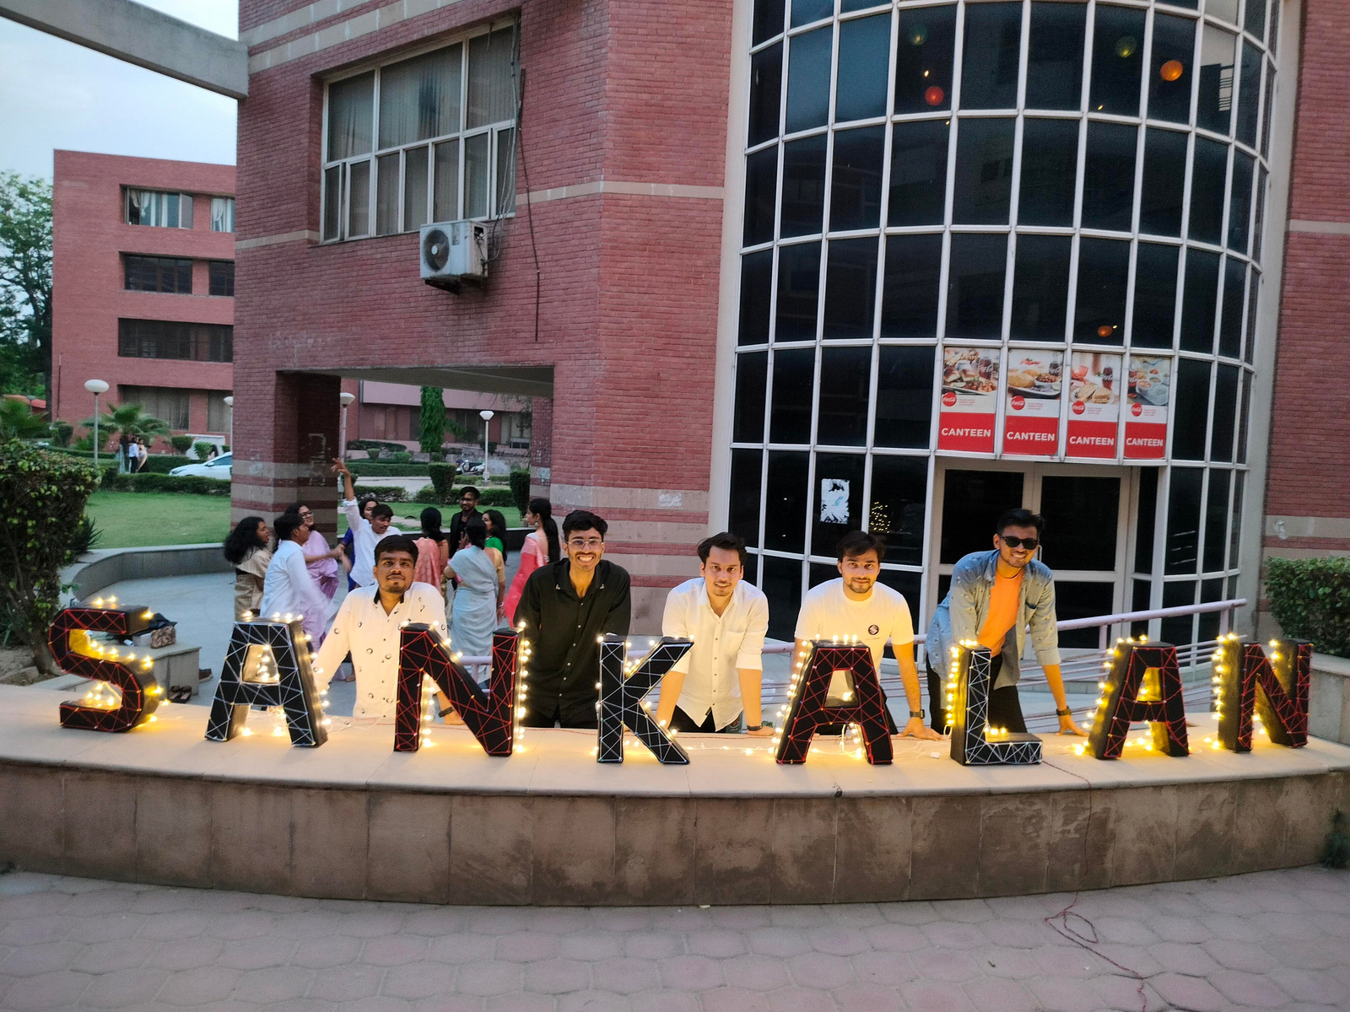
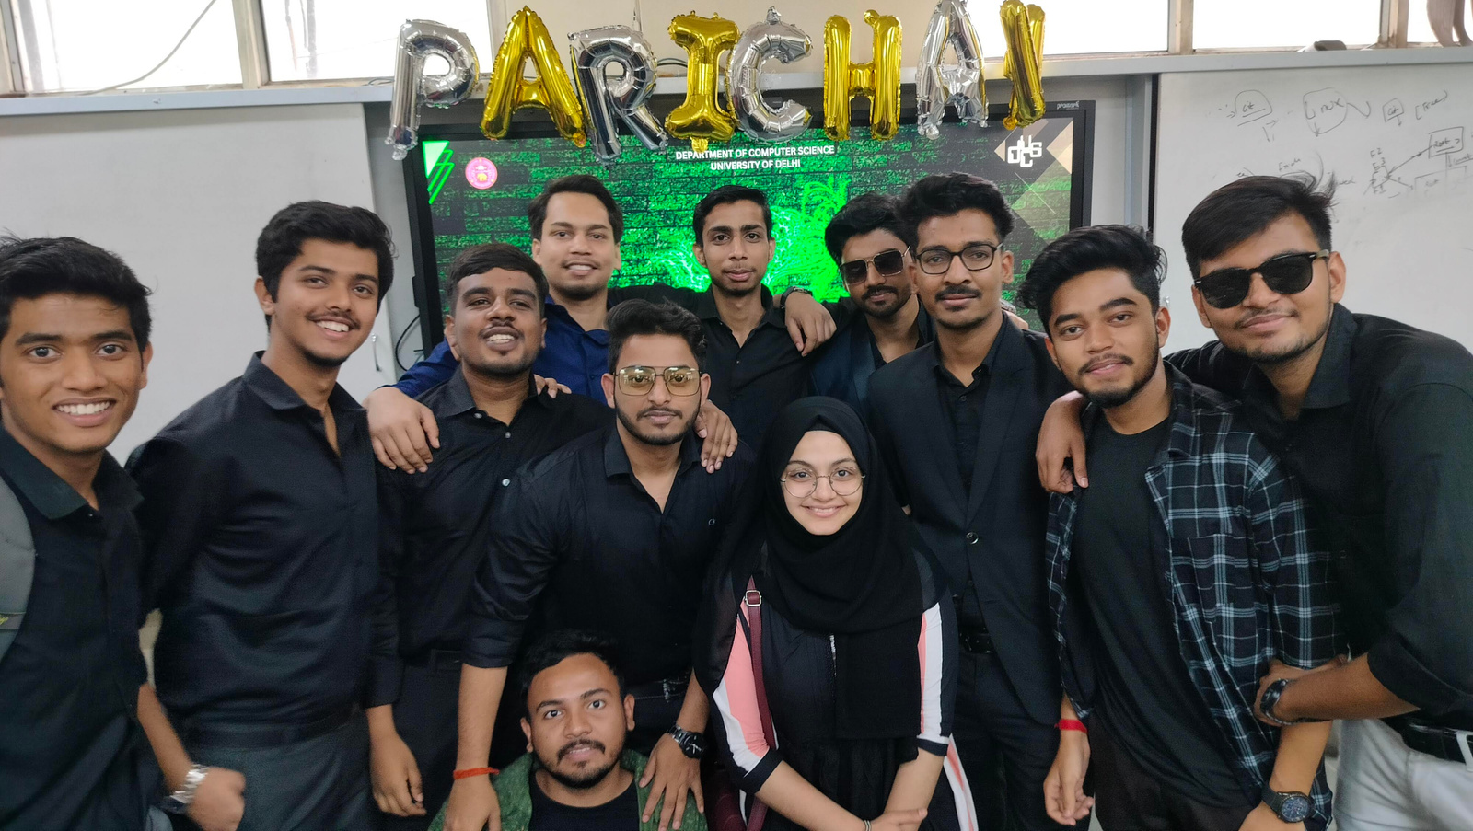

PHOTOS ZONE
click me
2023 Orientation Session | DUCS | Dept. of Computer Science, University of Delhi

Slide 21
TIPS ZONE
5 Tips
1. DSA (not only me)
2. Skill Development and projects
3. CGPA and Free Internship
4. Hackathons and Open source
5. Connections and Mentorship
2023 Orientation Session | DUCS | Dept. of Computer Science, University of Delhi

Slide 22
Seniors’s Personal Tips
2023 Orientation Session | DUCS | Dept. of Computer Science, University of Delhi

Slide 23

OPPORTUNITIES AHEAD
2023 Orientation Session | DUCS | Dept. of Computer Science, University of Delhi

Slide 24
PLACEMENTS VS RESEARCH
2023 Orientation Session | DUCS | Dept. of Computer Science, University of Delhi

Slide 25
RESOURCE ZONE
Paid Courses
https://opensource.guide/how-to-contribute/
https://linktr.ee/dayachaudhary
2023 Orientation Session | DUCS | Dept. of Computer Science, University of Delhi

Slide 26
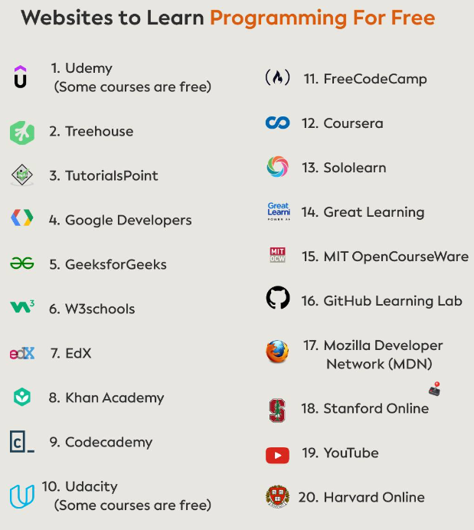
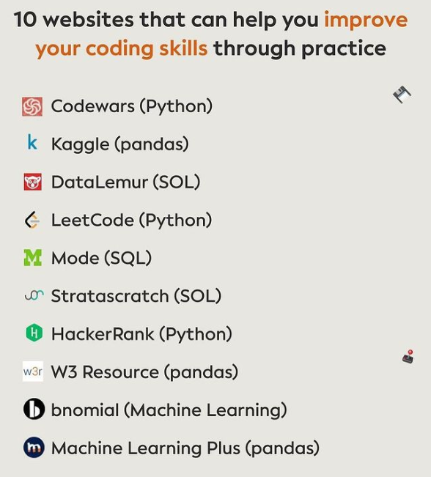

Slide 27

2023 Orientation Session | DUCS | Dept. of Computer Science, University of Delhi

Slide 28
THANK YOU
Presentation by MCA Batch(2022-2024)
MCA, MSc | 2023-2025
Dept. of Computer Science, University of Delhi

